Slide 1

EID LIMS
Goals, Achievements,
Work in Progress (EID Revamp)

Slide 2
Table of Contents
EID LIMS
EID LIMS Goal
EID LIMS Case in the broader EID Program
Achievements so far
EID Revamp

Slide 3
EID LIMS/Goal
EID LIMS:
A lab information management system that facilitates EID samples data collection at different stages leading to sample testing and dispatch of results.
As part of the system, A dashboard exists to enable data processing leading to the production of useful reports to guide in decision making processes.
EID LIMS Goal
To have in a place an EID LIMS that has accurate and complete data that can facilitate the production of timely reports for consumption by various key stake holders like facilities,IPs, Donors, CHAI, MOH

Slide 4
EID LIMS Case in the broader EID Program
EID Program goal:
All HIV-exposed infants in Uganda receive necessary testing, treatment, and care

Slide 5
EID LIMS Case in the broader EID Program
EID Program priority areas:
Commodities & EID Testing Materials
Ensure adequate supply of test kits, printing materials and other supplied needed for EID
1
Follow-up All Exposed Infants
Goal: > 80% exposed infants are initiated on ART
2
Transportation
Improving efficiency of National Sample Referral Transport Network (NSRT)
3
Access to EID
Expanding the reach of the EID program to include all HIV-exposed infants
4
Green = To be computerized in this revamp. Orange = To be computerized later.

Slide 6
EID LIMS Case in the broader EID Program
EID LIMS activities supporting our goal
Goal
All HIV-exposed infants
in Uganda receive necessary testing, treatment, and care
Objectives =>
Activities =>
Commodities
Ensure adequate supply of test-kits, etc…
Follow-Up
Ensure > 80% exposed infants initiated on ART
Transport
Access To EID
Provide database systems to assist in quantification, forecasting & procurement
Send
SMS / email reminders
Build Systems To
Track ART initiation and retention
Track & Re-enroll drop-outs: Ensure all infants, even NEGATIVE ones, complete full care cascade
No Reminders for CHAI/IPs
= Don’t know which facilities/infants to follow-up
= No ART
= Premature Death
No tracking of NEGATIVEs
= Breastfeeding risk
= Won’t know HIV status
= No ART
= Premature Death
No test Kits
= Infant HIV status unknown
= No ART
= Premature Death
No Reminders for mother
= She Doesn’t fetch results
= No ART
= Premature Death
Consequences
Consequences: If we miss our goal, 80% of affected children will die within 5 years

Slide 7
Current EID LIMS Feel
To save them…
Do Correct Activities → Achieve EID Objectives → Reach EID Goal
But we need information to choose the correct activities and also to do them well. Currently, we face the following problems:
    Lack of Reporting & Data-analysis tools
    Lack of Follow-up Management tools
    Lack of Commodity Management tools
(causing wastage & stock-outs)
The purpose of the EID revamp is to fix these 3 issues.
The resulting software tools will help CHAI to quickly get accurate information that can be used to make important decisions that move us towards our goal and save children’s lives.
Revamped EID Software → Better, Faster Decisions → Activities → Objectives → Goal

Slide 8
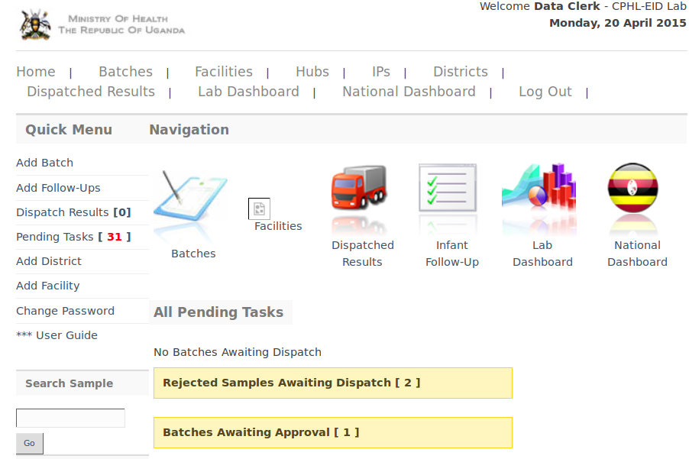
Current EID LIMS Feel

Slide 9
Achievements
Summary of achievements so far
EID LIMS in place facilitating data collection
Dashboard offering some reports

Slide 10
Achievements
Number of tests done:
Year | Tests | Expected | % tage | %Missed out
2012 | 77,407 | 115,759 | 66.9% | 33.1%
2013 | 88,107 | 119,592 | 73.7% | 26.3%
2014 | 97,141 | 123,443 | 78.7% | 21.3%
Total | 262,389 | 358,794 | 73% | 27%
Expected refers to the number expected as per the projected HIV positive deliveries for that year

Slide 11
EID LIMS Revamp
System in place has challenges
Poor underlying system architecture implying:
-It is hard to understand
-Takes long to resolve an error
-Takes long to add a feature/functionality
-Overall performance is compromised making the system slow and inefficient
Inaccurate data which leads to inaccurate reports and hence can have a negative impact on the decisions made
Low data validation

Slide 12
EID LIMS Revamp
EID Revamp work:
Same user interface but with enhancements for faster usage
Improve on validations
Redesign of the Code structure that is modular and better organized.
Redesign of DB structure that is efficient and more logical
SMS module to be added to facilitate communication of alerts like to pick results, follow-ups for positive infants

Slide 13
EID LIMS Revamp
EID Revamp Work...
Ability to print results at Hubs and in future at facilities
Lab Commodities/logistics management and forecasting
Building of CPHL Technical capacity to ensure sustainable system support and development
Data back up and recovery that is auto – scheduled and off site
Improvement on access rights to enhance on security by ensuring each user has one account and is only allowed one log in at a time

Slide 14
EID LIMS Revamp
EID Revamp Work: Work on Dashboard
Filtering to facility level,
Ability to download and print reports,
Defining of user access to the reports.
M&E tool to evaluate usage of the Dashboard
Develop quarterly performance scorecard for selected stake holders

Slide 15
- End -

